Slide 1
Professional Tennis
Sebastian Buxman

Slide 2
AGENDA
Introduction
Understanding the data
Wrangling the data
Predictions
Conclusion

Slide 3
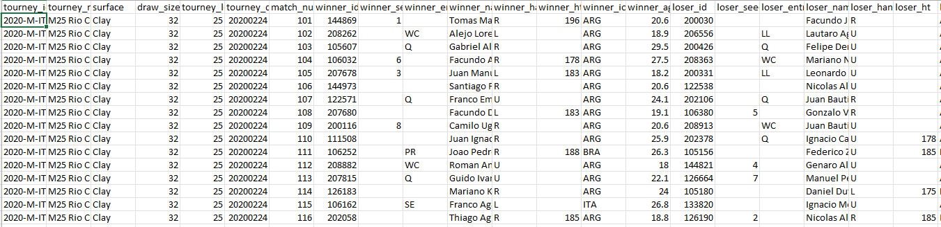
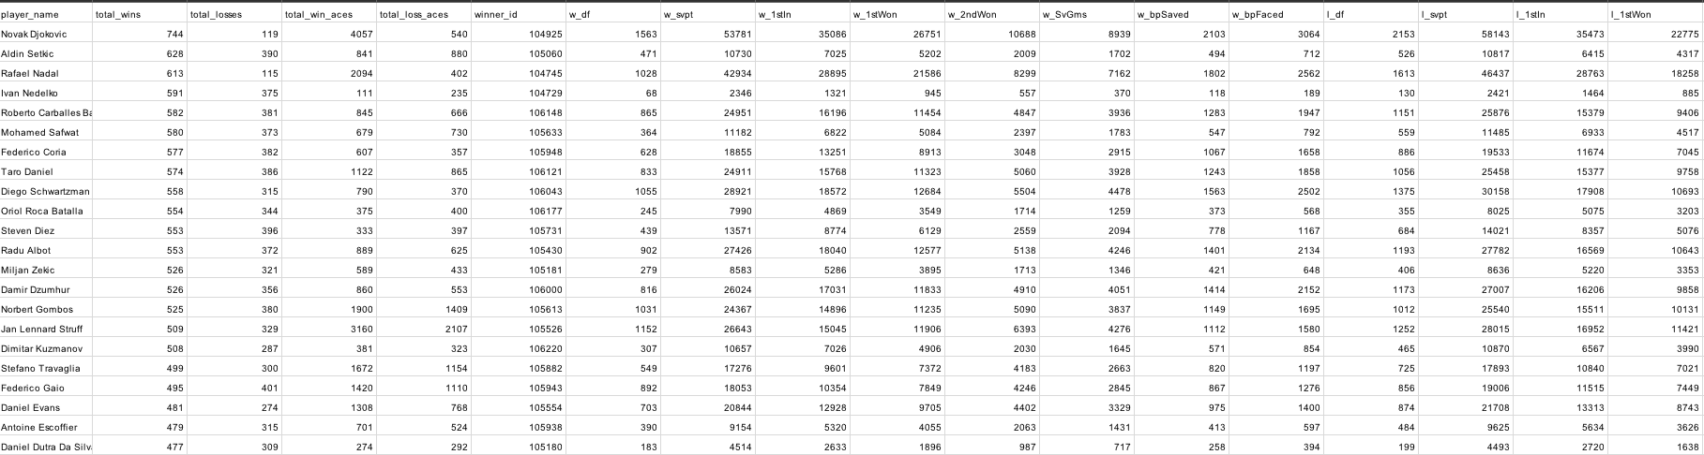

Slide 4
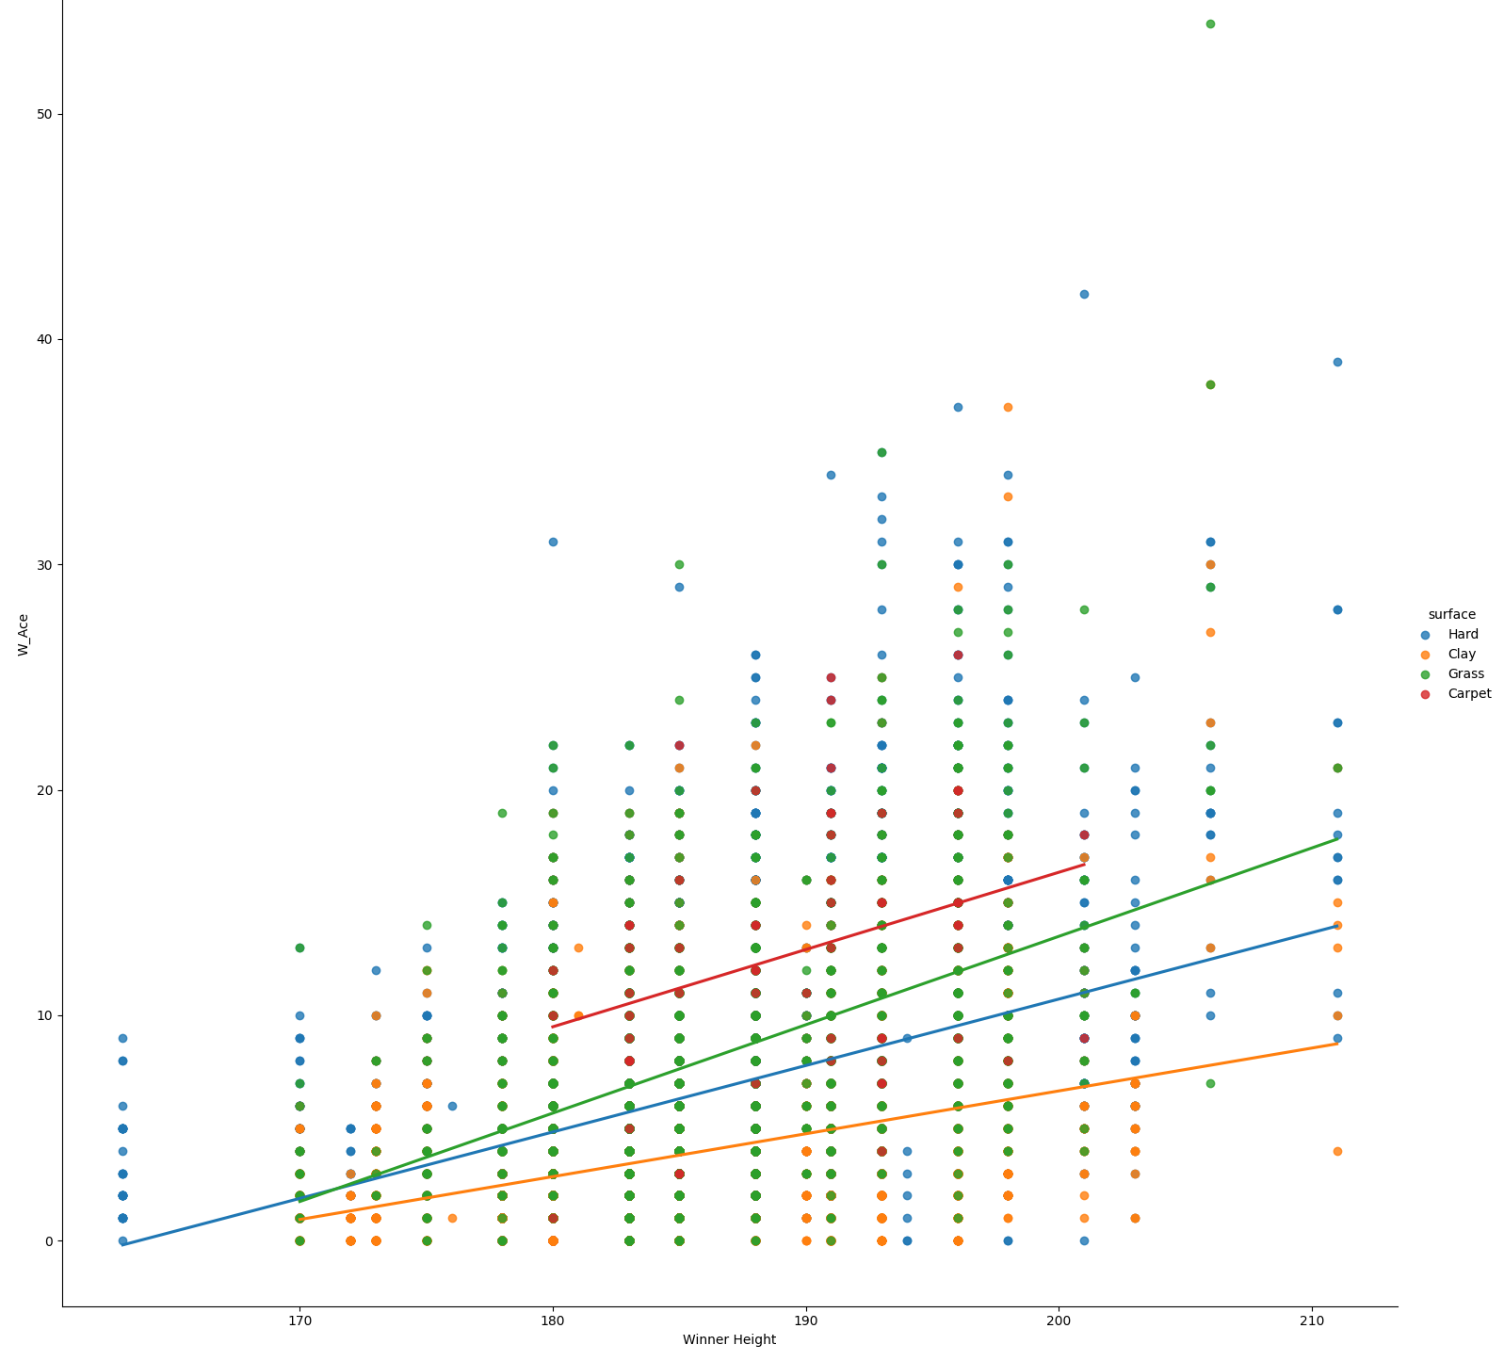
Aces vs Player height:
There is a clear positive correlation between winner aces and winner height.

Slide 5
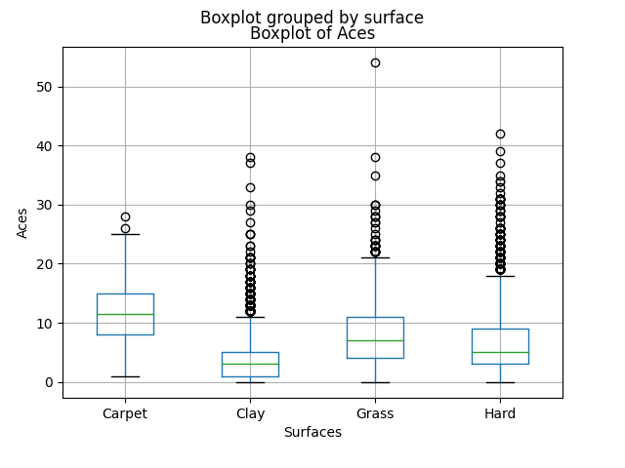
How does surface affect Aces?
Due to the way the ball bounces it gives the opponent more time to reach the ball, therefore less aces are hit.

Slide 6
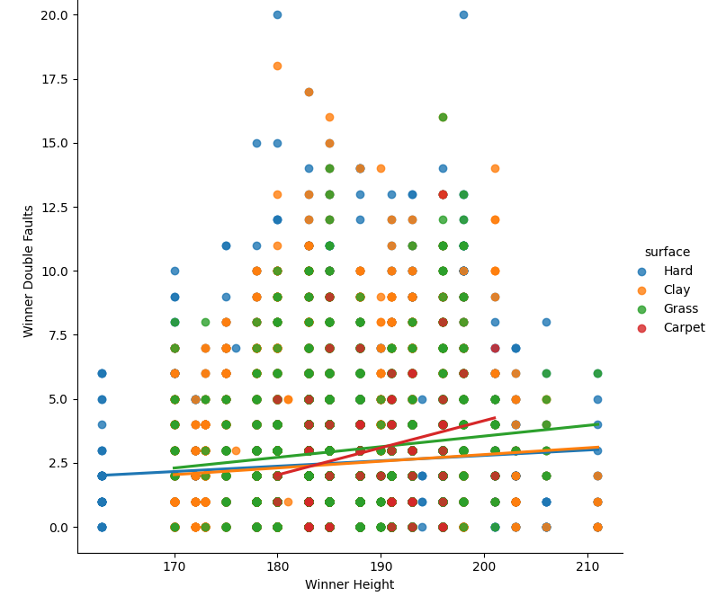
Double faults vs height
Height affects double faults less than aces.

Slide 7
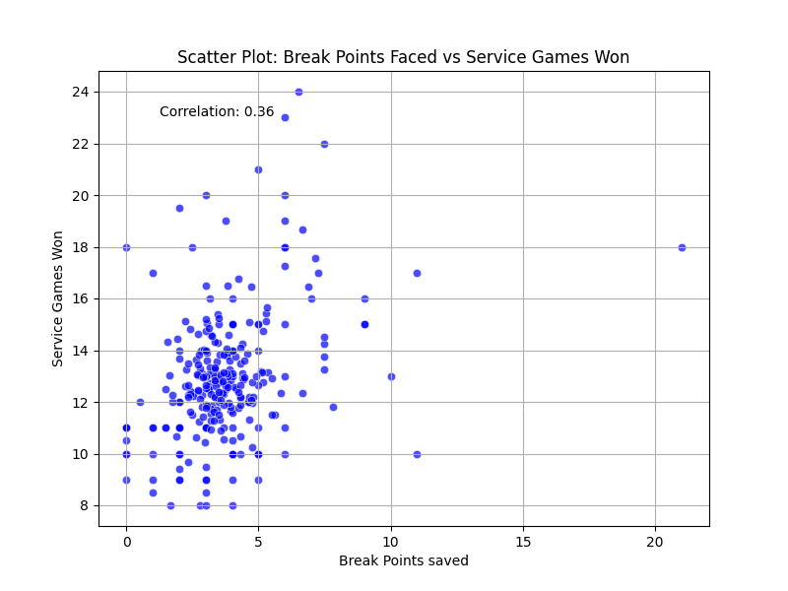
Break Points Faced vs Service games won
Little correlation between service games won and break points faced. Winning players are facing a low amount of break points on their own serve.

Slide 8
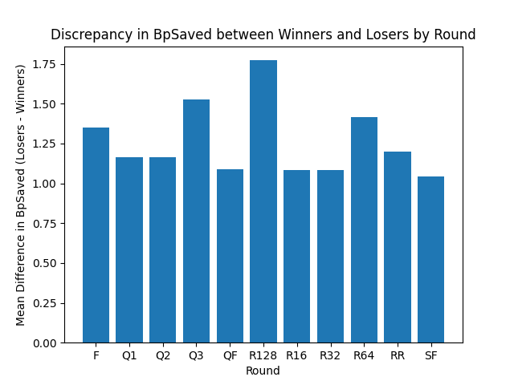
Break points saved based on round:
Winners are facing fewer break points against their own serve.

Slide 9
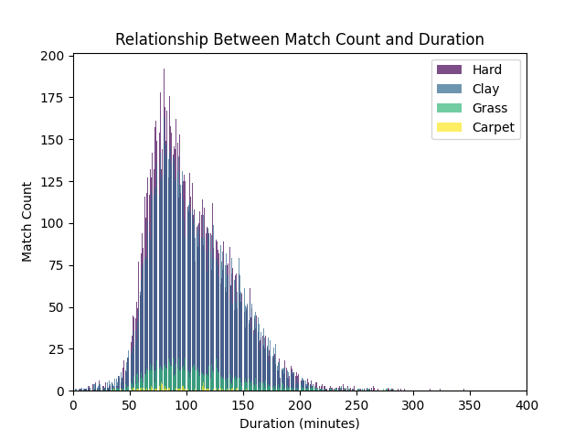
Amount of matches VS duration
Hard court and clay have more matches lasting longer than carpet or grass.

Slide 10
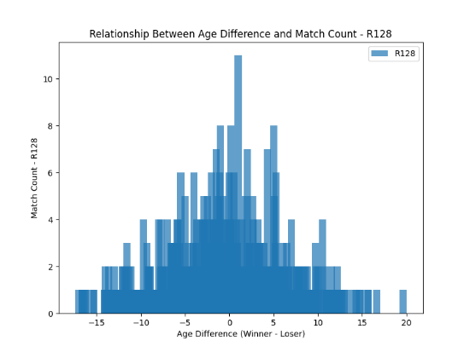
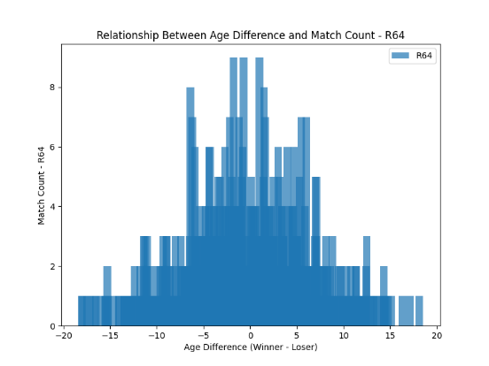
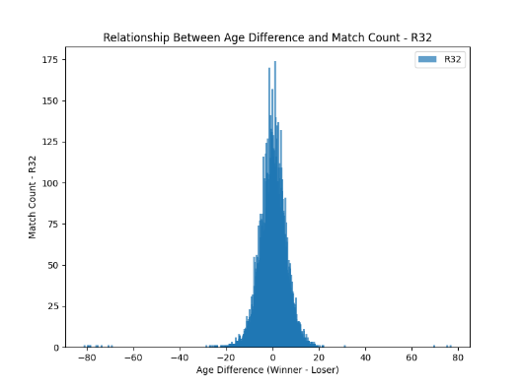
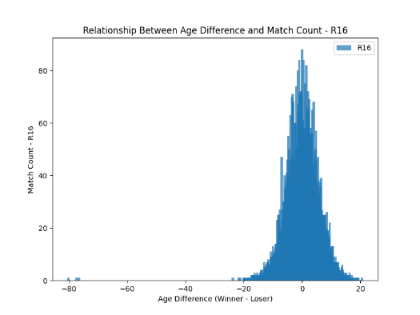
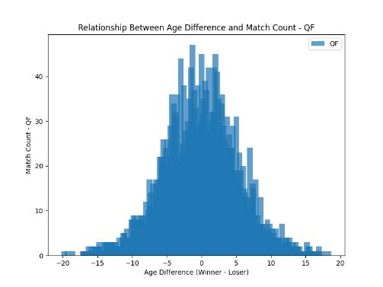
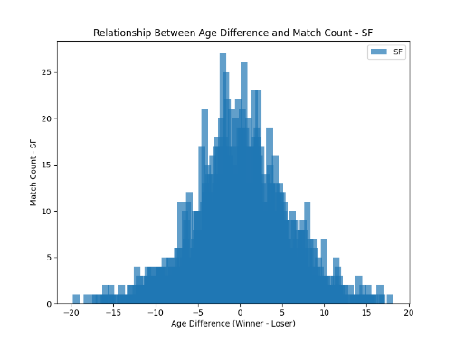
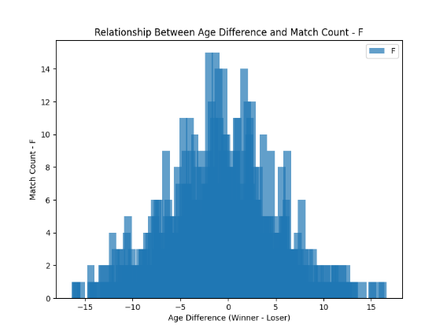

Slide 11
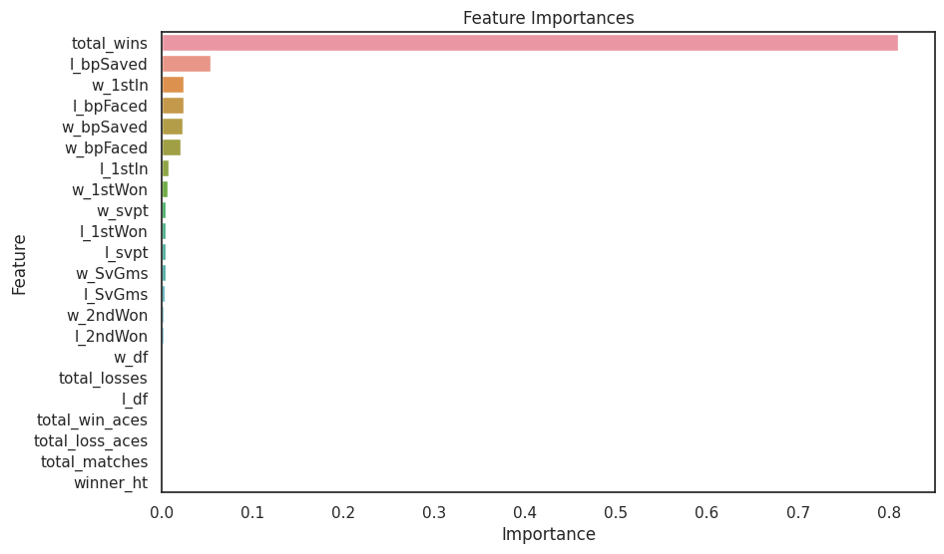
Feature Importance

Slide 12
Accuracies

Slide 13
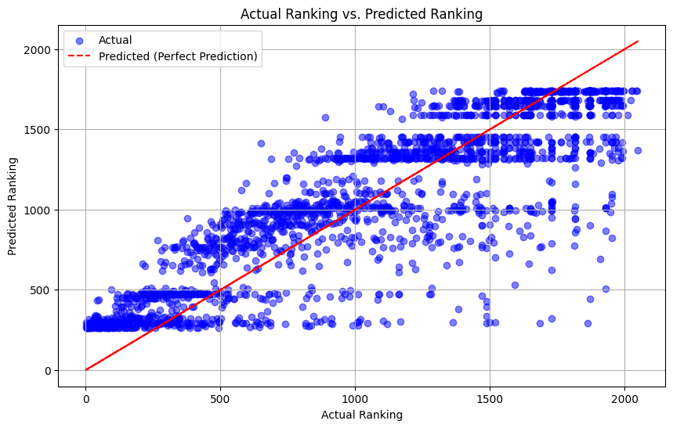

Slide 14
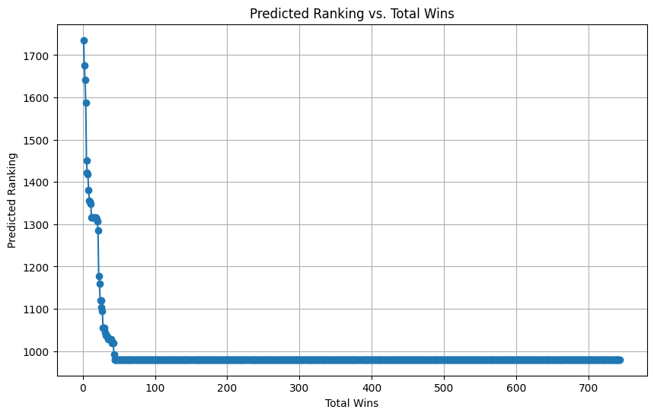

Slide 15
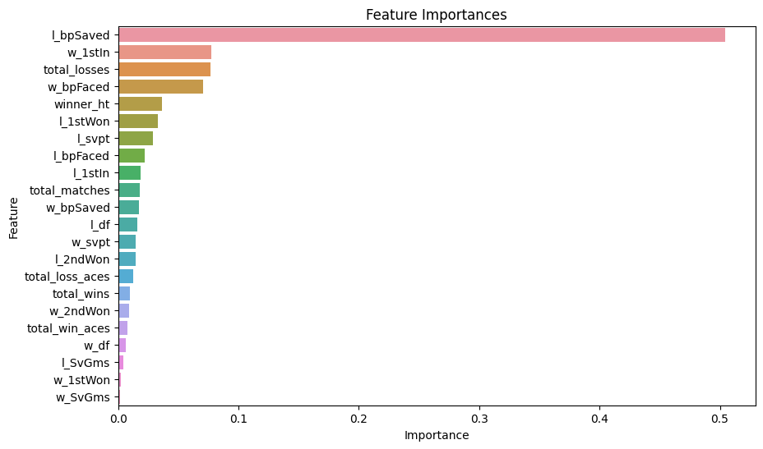

Slide 17
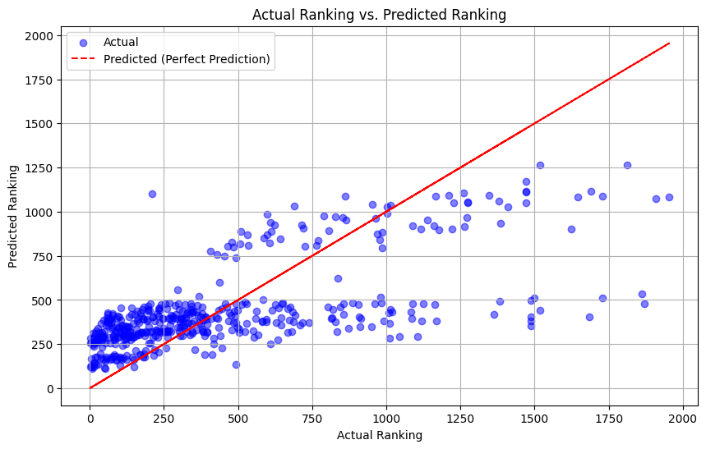

Slide 18
